Slide 1
STATIC WEBSITE HOSTING
PROJECT HANDOVER PRESENTATION

Slide 2
Environment Overview
Two environments: UAT & PROD
Separate Terraform configurations
Shared promotion workflow
GitHub-based source repository
Independent CloudFront distributions

Slide 3
Infrastructure Inventory
Component/Service | Region | Value/Scope
Terraform Code | Local | IaC
AWS Region (for Regional Resources) | ap-southeast-1 (Singapore) | S3 Buckets, CodePipeline, EventBridge, Lambda, SNS
CloudFront | Global | CDN
IAM Roles & Policy | Global | Least Privilege Access

Slide 4
Access & Permissions
IAM roles for Terraform execution
Pipeline service roles
Lambda execution role
GitHub CodeConnection
SNS email subscribers

Slide 5
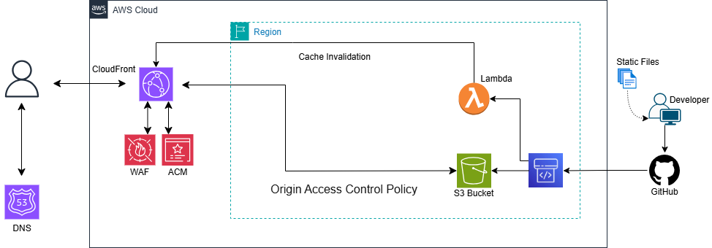
Architecture Overview and Diagram

Slide 6
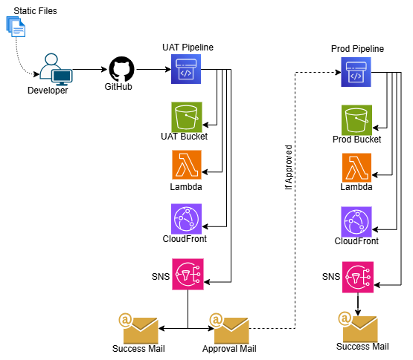
Architecture Overview and Diagram

Slide 7
Backup Operational Process
Terraform state backup (recommended remote backend)
Infrastructure redeploy via terraform apply
CloudFront invalidation on new deployment
Recreate UAT before PROD if state lost

Slide 8
Knowledge Transfer (KT) Details
Terraform module explanation
Environment variable walkthrough
Pipeline workflow explanation
Failure scenario demo
Documentation handover completed

Slide 9
Pending Activities
Optional remote backend configuration
Enhanced monitoring setup
Multi-region DR implementation
Cost monitoring dashboard
Security hardening review

Slide 10
Handover Acceptance
Access verified
Documentation received
KT completed
No pending critical issues
Formal acceptance sign-off

Slide 11
Formal Sign-Off
Infrastructure deployed successfully
All planned scope delivered
Testing completed
Documentation shared
Client acceptance pending signature

Slide 12
Thank You

